Slide 1
Why Have Economic Reforms in Mexico Not Generated Growth?
Author(s): Timothy J. Kehoe and Kim J. Ruhl (2010)

Slide 2
Abstract
Following its opening to trade and foreign investment in the mid 80s, Mexico's economic growth has been modest, in comparison with that of China.
By comparing both countries the author’s conclude that the relation between openness and growth is not a simple one.
Using standard trade theory, the author’s find that Mexico has gained from trade, and by some measures, more so than China.
Kehoe and Ruhl sketch out a theory in which developing countries can grow faster than the U.S. by reforming.
As a country becomes richer, this sort of catch-up becomes more difficult.
Absent continuing reforms, Chinese growth is likely to slow down sharply, perhaps leaving China at a level less than Mexico's real GDP per working-age person.

Slide 3
Overview
Mexico’s Economic History
China and Mexico’s Trade, Foreign Direct Investment (FDI), and Economic Growth
Literature Review
Gains from Trade and Real GDP
The Neoclassical Growth Model and Power of Productivity
Directions for Future Research and a Proposed Theoretical Framework
Conclusion

Slide 4
I. Mexico’s Economic History: The Origins of the Debt Crisis
Latin American borrowing from US commercial banks and other creditors increased dramatically during the 1970s.
From 1973 to 1981, the external debt of the public sector in Mexico had grown at an average annual rate of more than 30%, that is from $4 billion to $43 billion.
Mexico in the early 1980s was no longer an agricultural economy, but it had become a power in the international oil market at a time when the price of oil was at an all-time high.
The Mexican government borrowed against future oil revenues to finance investments.
The external environment began to worsen in the first half of 1981, as a sharp increase in short-term interest rates in the United States and other major countries was followed by a softening of demand for oil.

Slide 5
I. Mexico’s Economic History: The Eruption of the Debt Crisis 1982-85
Mexico’s large current account deficits was a fast growing level of external indebtedness.
A sharp decline in international reserves forced the Mexican government to devalue the peso, increasing the dollar-denominated debt burden, mainly to US commercial banks.
Despite the devaluation of the peso, Mexico is unable to stop its loss of reserves and runs out of cash.
Mexico’s Minister of Finance Jesus Silva Herzog informs the US government and the IMF that Mexico is unable to service its external debt of US$ 80 billion.
Mexico was the first of many Latin American countries to default on its sovereign debt.

Slide 6
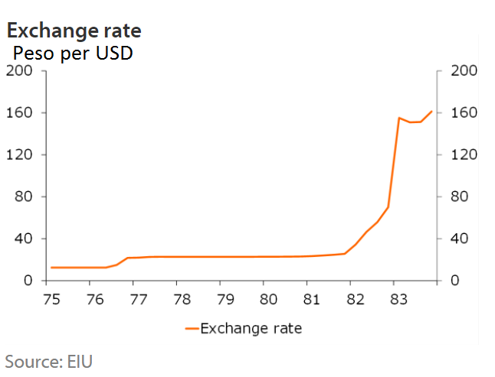
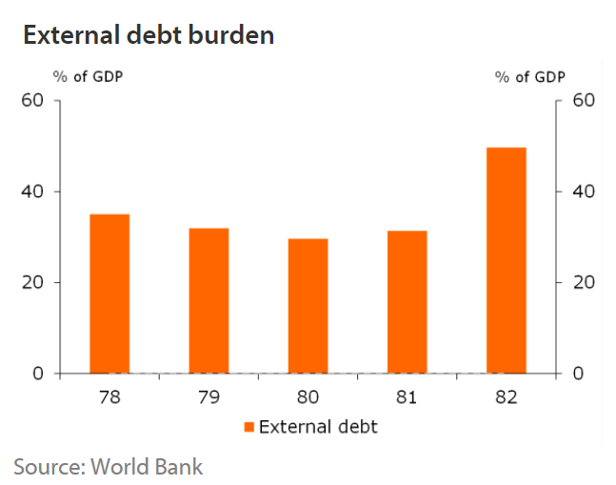
I. Mexico’s Economic History: The Eruption of the Debt Crisis 1982-85 Cont’d.
In December 1982, the IMF approves a US$ 3.8 billion loan to the Mexican government, but they had to implement a series of free market reforms.
The result of these reforms resulted in the North American Free Trade Agreement (NAFTA) in 1994.

Slide 7
II. China and Mexico’s Trade, Foreign Direct Investment (FDI), and Economic Growth
The reforms included fiscal reforms, privatization of government operated firms, and opening the economy to trade and foreign investment.
The paper focus is on the reforms that opened Mexico to trade and foreign investment.
Despite of these reforms, Mexico's economic growth since 1985 has been modest.
This growth is especially disappointing if we compare it with that of China, another large, less developed country that started opening itself to the rest of the world after Mexico.

Slide 8
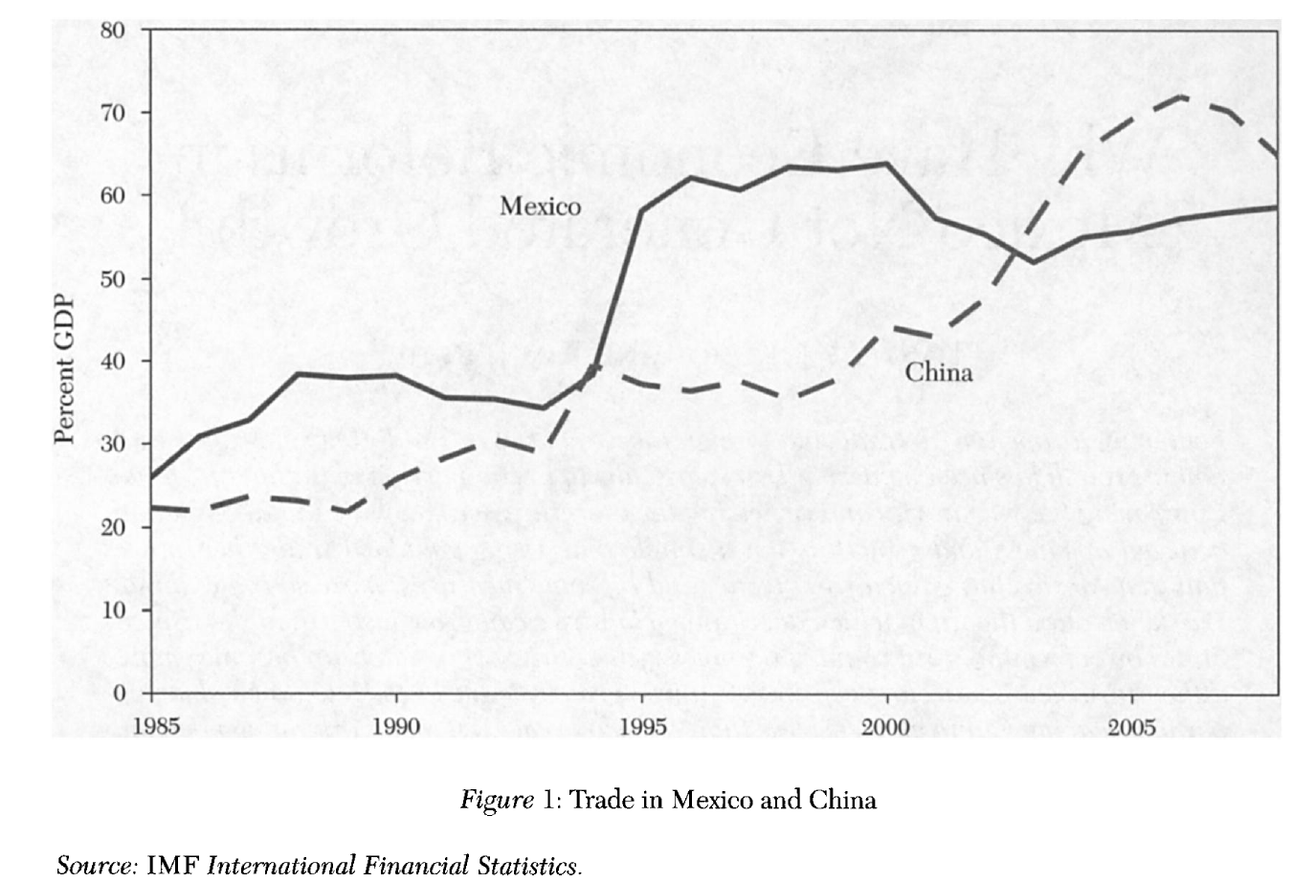
Trade in goods and services as a percentage of its GDP
In 1995 China had the largest merchandise trade among emerging and developing economies, accounting for 12.7%.
During the same period Mexico was second accounting for 7%.
In 2008 China was still the largest trader at 22.3%; whereas Mexico dropped to seventh at 5.4%.

Slide 9
Inflows of Foreign Direct Investments (FDI)
In 1995 China was the largest recipient of FDI among emerging and developing economies, accounting for 33.4%; whereas Mexico was second accounting for 8.5%.
In 2008 China still had the largest inflows of FDI at 14.8%; whereas Mexico dropped to seventh at 3.2%.

Slide 10
Economic growth in Mexico
Real GDP per working-age person (15-64 years old) grew by 510% in China over the period 1985-2008; or 8.2% per year.
Real GDP grew by only 10% in Mexico over the period 1985-2008; or 0.4% per year.
Notes:
***Notice that the vertical axis in figure 3 has a log base so that Chinas relatively constant shows up as being close to linear.

Slide 11
III. Literature Review
The purpose to revise existing literature by the authors of the paper is to try to answer why Mexico stagnated after opening itself to trade and foreign investment while China grew rapidly.
In order to do that the authors focus on three types of studies:
Cross-Country Growth Regressions
Studies of Mexico’s Stagnation
Studies of China’s Fast Growth

Slide 12
1. Cross-Country Growth Regressions
Main focus is the work by Jeffrey D. Sachs and Andrew M. Warner (1995).
Sachs and Warner construct a univariate measure of openness that classifies a country as closed if it had any one of five characteristics:
A high average tariff rate,
Nontariff barriers on a large fraction of imports,
A socialist economic system,
A state monopoly over major exports, or
A high black-market premium during either the 1970s or the 1980s.
Sachs and Warner found that countries that are open, have on average 2.4% per year higher growth in real GDP per capita than those that were closed.
Mexico is classified as closed in this paper until 1986, but open thereafter.
China is classified as closed due to their socialist economy.
Notes:
Last point: Although China has progressively liberalized since 1978, its trading system was still full of quantitative restrictions at least as of 1994.

Slide 13
1. Cross-Country Growth Regressions Cont’d.
The authors say that of all the literature out, there are three general aspects worth noting:
There is a positive and robust relationship between a country's trade as a share of GDP and its growth rate, but also trade share is not a direct measure of policy and the causal relation between the trade share and growth is problematic.
The relationship between measures of policies related to openness and growth does not seem to be clear.
Many of the researchers who study the relationship between openness and growth do so without being closely guided by a theoretical model.

Slide 14
2. Studies of Mexico’s Stagnations
Kehoe and Ruhl review research that identifies factors believed to impede growth in Mexico. For each of these factors, they ask:
Does China share this characteristic? And, if so, why has it not impeded growth in China?
Why do these factors impact growth differently in the two countries?
Their main focus is on the popular theory that Mexico’s stagnation is due to its inefficient financial system and lack of contract enforcement.
They revise the work by Raphael Bergoeing et al. (2002, 2007) on the growth experiences of Mexico and Chile following their economic crisis in the early 1980s.

Slide 15
2. Studies of Mexico’s Stagnations Cont’d.
The authors concluded that:
An inefficient financial sector, lack of contract enforcement, and rigidities in the labor market kept Mexico from benefiting from its reforms to policies involving foreign trade and investment.
China also has these same problems, but argue that these did not impede growth as they did in Mexico because China is at a lower level of development.
Perhaps Chinas growth is even part of Mexico's problem?

Slide 16
3. Studies of China’s Fast Growth
Kehoe and Ruhl literature review reveals that China’s economic growth was due to:
Rapid TFP growth as the driving force behind Chinese economic growth.
Productivity differences between entering and exiting firms during 1998-2005, which explains about half of Chinese TFP growth, as presented in Loren Brandt and Xiaodong Zhu (2010) work.
Identifying reallocation of resources from inefficient firms to efficient firms as a significant determinant of TFP growth, as presented in Chang-Tai Hsieh and Peter J. Klenow (2009) work.

Slide 17
Why have these factors not been at work in Mexico?
The authors conclude that Mexico’s poor economic performance compared to China was due to:
Mexico’s lack of productivity growth, not in manufacturing but in the rest of the economy like other sectors such as petroleum extraction, electricity, telecommunications, and transportation.
Mexico’s inefficient allocation of credit when the Mexican government controlled the banking system from 1982-1991, as shown by Bergoeing et al. (2002, 2007).

Slide 18
IV. Gains from Trade and Real GDP
The empirical evidence on the link between trade and growth is inconclusive.
Changes in import penetration ratios are similar in Mexico over 1990-2000 and China over 1998-2008.
The authors consider two other measures:
An adjustment to real GDP to account for terms of trade effects
A measure that accounts for the gains from the greater varieties available through trade
These measures indicate that Mexico has gained more from trade than has China
Changes in the terms of trade impact welfare in the country, but will generally not translate into changes in real GDP.

Slide 19
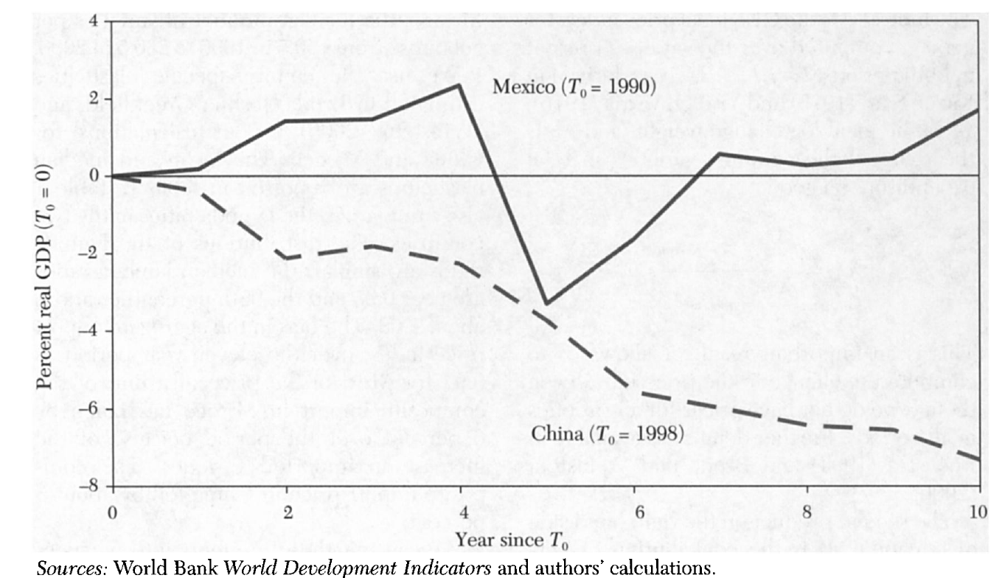
IV. Gains from Trade and Real GDP: Gains from the Terms of Trade
Terms of Trade Premium in Mexico and China*
In Mexico the average terms of trade premium is 0.17% per year.
In China, the terms of trade have steadily deteriorated.
Chinese real GDP overstates the growth in real GDI by almost 8 percentage points over time considered.
The policies that keep the relative price of imports in China high make Chinese consumers worse off than the real GDP data indicate.
Notes:
- Trade premium = percentage deviation of real GDI from real GDP for Mexico and China.
- The gain, relative to real GDP, that accrues to a country because of changes in the terms of trade.
- The crisis in 1994-95 was accompanied by a sharp deterioration in the terms of trade; the impact of the financial crisis was worse than real GDP indicated, and the recovery more robust.

Slide 20
IV. Gains from Trade and Real GDP: Gains from New Varieties
The "new trade models" based on differentiated varieties and increasing returns to scale imply that trade liberalization not only changes the prices of goods that were already available for consumption, but also changes the composition of varieties that are available for consumption.
The authors show that following trade liberalization, newly traded goods can significantly change the composition of trade between countries.
They apply a technique developed in Feenstra (1994) to compute the gains from the importation of new varieties for China and Mexico.

Slide 21
IV. Gains from Trade and Real GDP: Gains from New Varieties Cont’d.
For China, real GDP overstates the growth in real income by 0.76% per year due to the deterioration of the terms of trade.
The growth rate of real income per capita in China is 8.33% compared with the 8.99% growth in real GDP.
In Mexico, the gains from trade imply that real income has grown about 0.30% per year faster than real GDP. So, despite slow growth in GDP, Mexico has gained substantial benefits from liberalization.
This measurements are only capturing the improvement in welfare that comes from consuming expensive goods or from consuming varieties of goods as a result of barriers.

Slide 22
V. The Neoclassical Growth Model and Power of Productivity
Authors employ a neoclassical growth model, an aggregate Cobb-Douglas production function, which they rewrite as:
$\frac{Y_{t}}{N_{t}}\text{ =} A_{t}^{\frac{1}{\left(1−α\right)}}{\left(\frac{K_{t}}{Y_{t}}\right)}^{\frac{α}{\left(1−α\right)}}(\frac{L_{t}}{N_{t}})$ ; where $Y_{t}$ is output
$A_{t}$ is TFP
$K_{t}$ is capital
$L_{t}$ is labor output
Assumptions:
Hours worked per worker is constant, which allows to use the number of workers as a measure to the labor input for both Mexico and China.
This is done because there is no data on hours worked in China, but data available for Mexico.*
Notes:
When At grows at a constant rate, the capital-output ratio Kt/Yt and the participation rate Lt/Nt are constant.

Slide 23
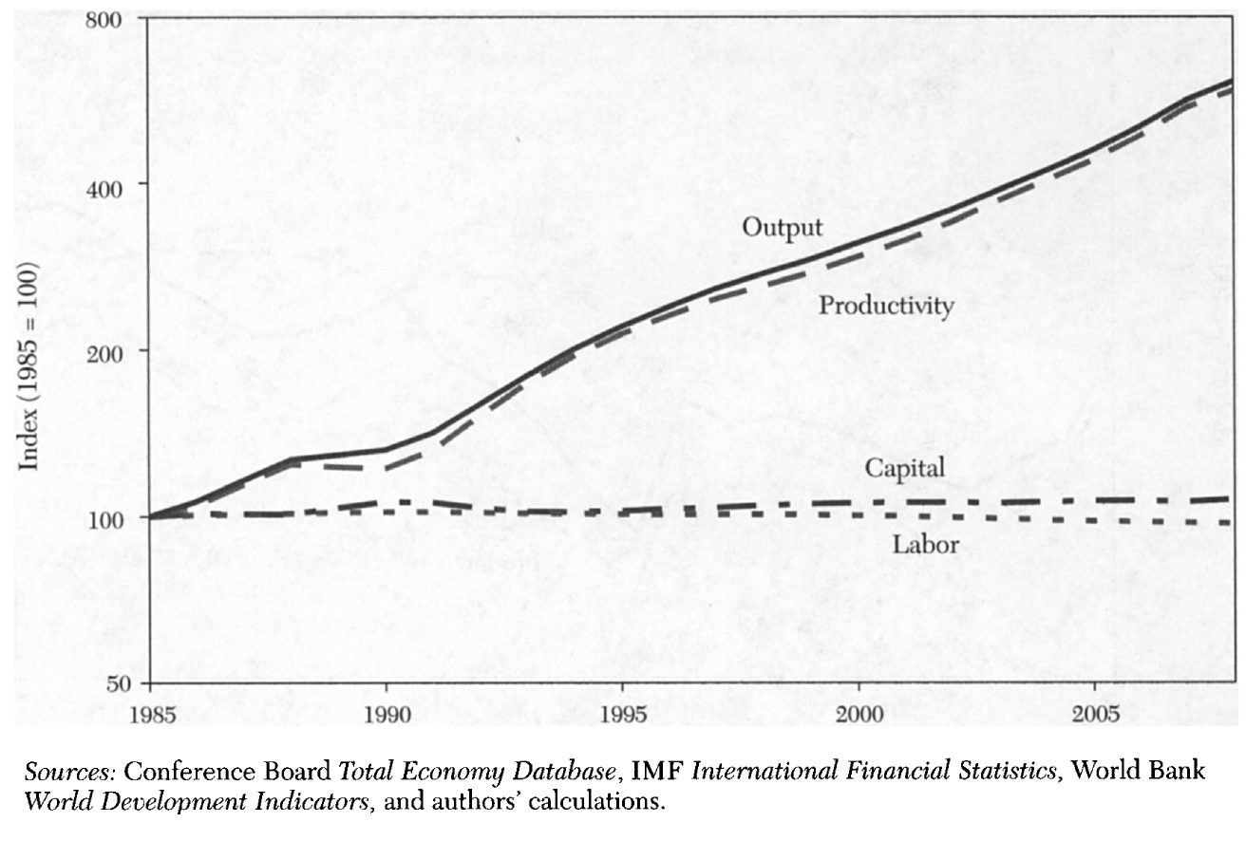
V. The Neoclassical Growth Model and Power of Productivity Cont’d.
Growth Accounting for China:
Chinese data between 1985-2008 are close to a balanced growth path, but at a high rate of growth.
In the mid-1990s, growth in output accelerates, and much of this acceleration is due to growth in the capital factor and, especially, the labor factor.

Slide 24
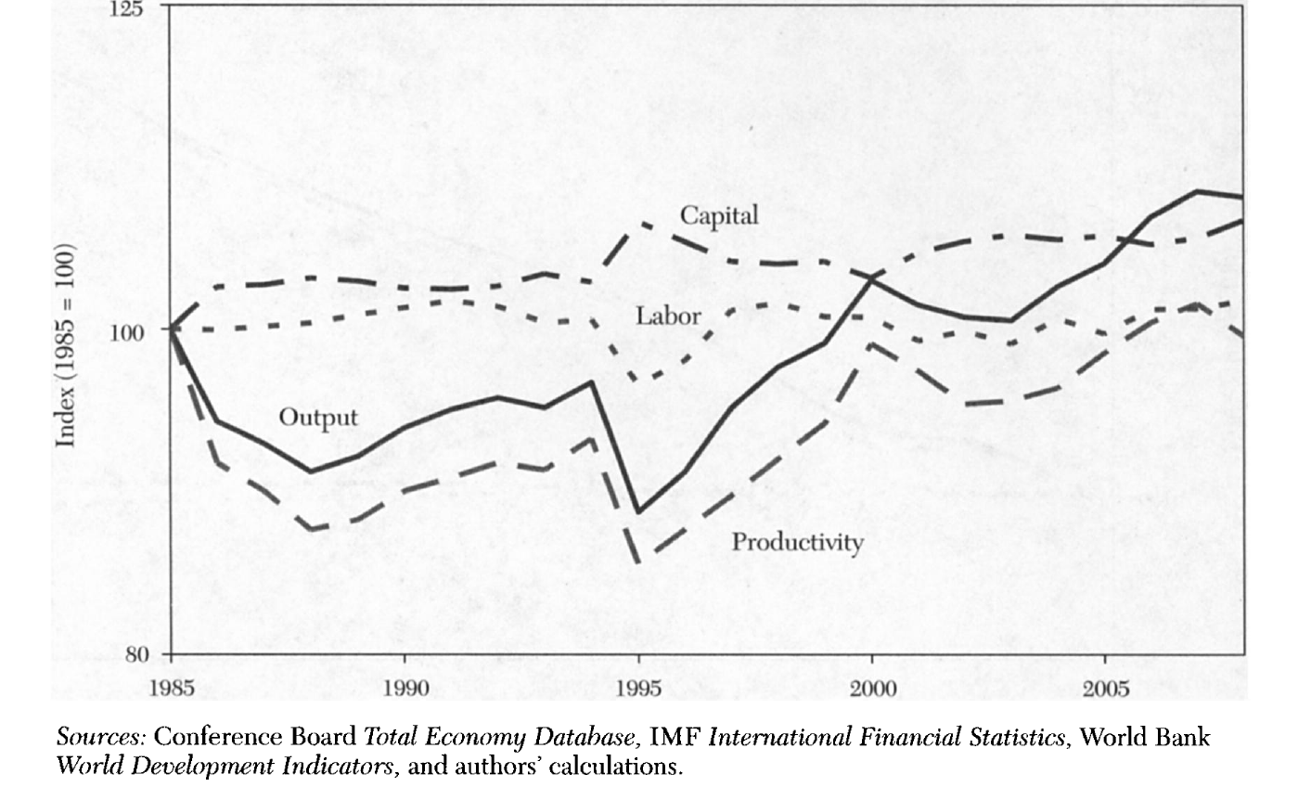
V. The Neoclassical Growth Model and Power of Productivity Cont’d.
Growth Accounting for Mexico
Poor performance in terms of real GDP growth is driven by a worse performance in terms of TFP growth, but since 1995 there has been some GDP growth and that growth has been driven by TFP growth.
Between 1995 and 2000, real GDP per working-age person grew by 3.2% per year, while overall, between 1995 and 2008, it grew by 1.7% per year.

Slide 25
V. The Neoclassical Growth Model and Power of Productivity Cont’d.
The most important findings from the authors:
Capital is less important
Increases in productivity are the driving force of economic growth
Understanding the growth in TFP is essential of why some countries grow faster than others
There is a need to reassess some of the research that employs growth regressions

Slide 26
Why Mexico stagnates while China grows?
Most of Mexico's trade and FDI inflows are with the U.S. and the predominance of intrafirm trade between Mexico and the U.S. reduces the incentives toward competition and innovation that would arise from trade and foreign investment reforms.
Mexican manufacturing seems to be complementary with U.S. manufacturing, while Chinese manufacturing is a substitute for both Mexican and U.S. manufacturing.
It might not be the Mexican manufacturing sector, or at least those subsectors most involved in trade, but other sectors.

Slide 27
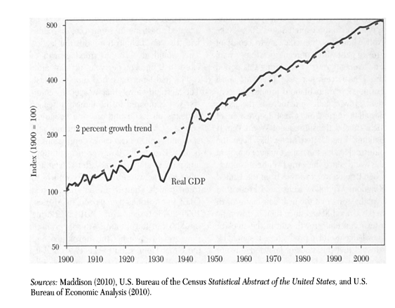
VI. Directions for Future Research and a Proposed Theoretical Framework Cont’d.
Kehoe and Ruhl propose to use the economic performance of the U.S. over the past century as a starting point.
The data shows a constant growth path with 2% growth per year. The average growth rate during 1900-2008 was 1.99% per year.
The absolute level that a specific country is at compared to the industrial leader depends on its institutions and economic policies.
Changes in these institutions and economic policies can cause depressions or booms.
Eventually, however, if institutions and policies stabilize, and after capital and labor have adjusted, the country returns to trend growth.
Real GDP per Working-Age Person in the U.S. 1900-2008

Slide 28
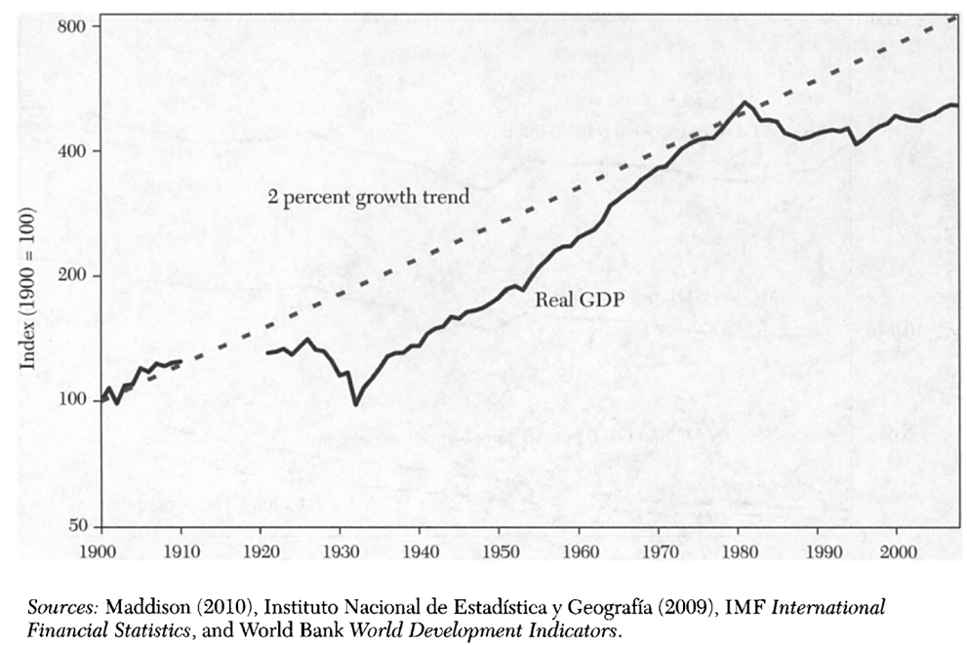
VI. Directions for Future Research and a Proposed Theoretical Framework Cont’d.
After a period of slow growth involving the Revolution and the Great Depression of the 1930s and its aftermath, Mexico began to grow rapidly during the early 1950s.
Between 1953 and 1981, Mexican real GDP per working-age person grew by 3.8% per year.
From 1981 through 1995, Mexico suffered the great depression analyzed contracting by 1.7% per year.
From 1995 to 2008, Mexico returned to close to trend growth, growing by 1.7%
Real GDP per Working-Age Person in Mexico 1900-2008

Slide 29
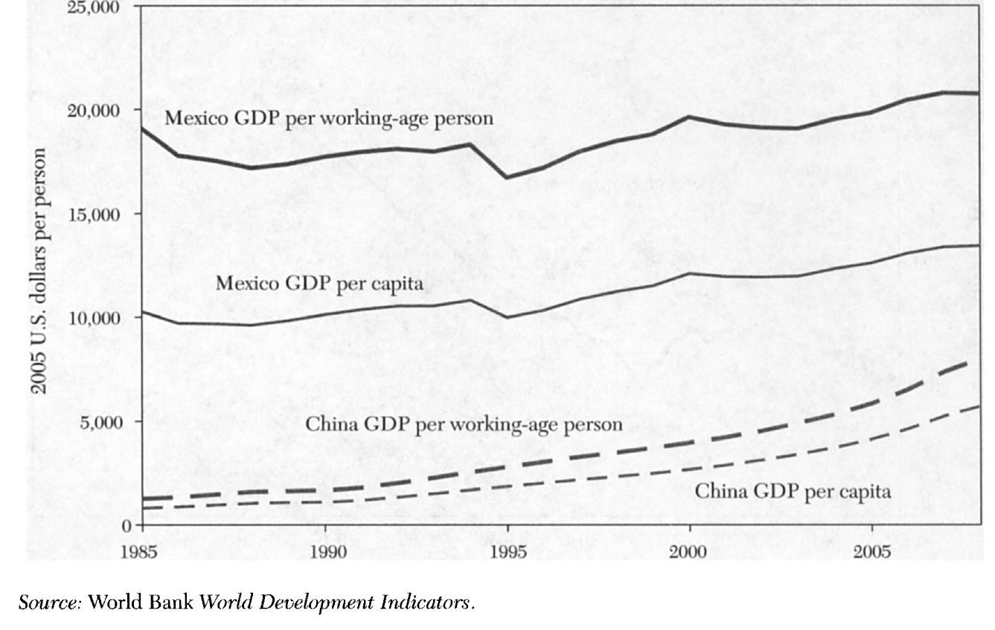
VI. Directions for Future Research and a Proposed Theoretical Framework Cont’d.
China has been growing more rapidly than Mexico but is still substantially poorer in 2008.
China’s GDP per working-age person in 2008 is $7,986 2005 U.S. dollars, which is only 38.5% of Mexico's $20,755 U.S. dollars.
China’s GDP per capita in 2008 was of $5,712 dollars, which is only 42.5% of Mexico’s $13,434 dollars.
Purchasing Power Parity GDP in Mexico and China

Slide 30
VII. Conclusion
It is easier to grow faster than the industrial leader when an economy is far behind.
An economy like China, or Mexico in 1953-8, can grow rapidly even with an inefficient financial system, lack of rule of law, and rigidities in the labor market.
Maybe Mexico is not experiencing the rapid catch-up growth that China is experiencing now because it already had this sort of catch-up during the period 1953-81.
As the country gets closer to the industrial leader, however, rapid growth stops and the country levels off at the trend growth rate of GDP per working-age person of 2% per year or a little less.
This seems to have occurred in Western Europe in the early 1970s, in Japan in the early 1990s, and in Chile in the late 1990s, to mention a few cases.
Unless China continues to reform, expect economic growth there to slow sharply at some point.

